Slide 1
Numerical Analysis
Course Instructor
Engr. Rahemeen
Rahemeen.bukc@bahria.edu.pk

Slide 2
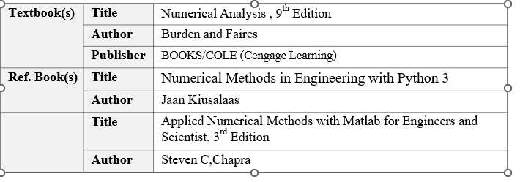
Course Details

Slide 3
Why Numerical Methods??
To accurately approximate the solutions of problems that cannot be solved exactly (by analytical method).

Slide 4
Some of the Applications
Image Processing
Computer Vision
Computer Graphics (rendering, animation),
Climate Modeling,
Weather Predictions,
“Virtual” crash-testing of cars etc.
medical imaging (CT = Computed Tomography),
CAD (Computer-Aided Design)
And many more

Slide 5
Some Challenges/Issues in NC
Accuracy
Precision
Errors (True & Approximate)
Significant Figures etc.

Slide 6
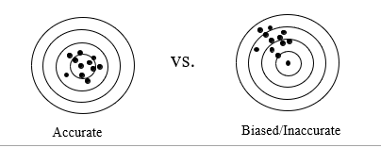
Accuracy:
Accuracy:
“How closely a computed value agrees with the true value”
Bias/Inaccuracy :
“A systematic deviation from the truth”

Slide 7
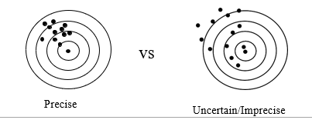
Precision:
Precision :
“How closely individual computed values agree with each other”
Uncertainty/Imprecision :
“magnitude of scatter”

Slide 8
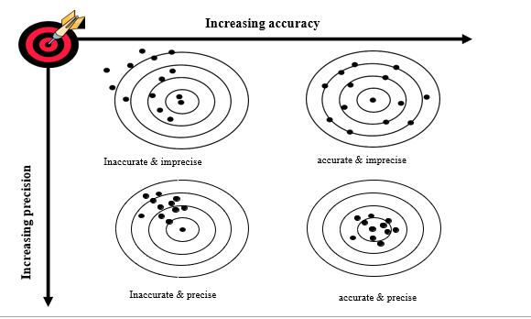

Slide 9
Error Analysis
The numerical error is the difference between the exact solution and the approximate solution.

Slide 10
Inherent Error
These types of errors occur due to simplified assumptions made during mathematical problems.
These also occur when the data is obtained from certain physical measurements of the parameters of the proposed problem.

Slide 11
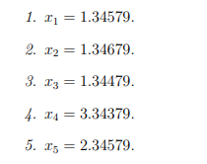
Round-off Error
The error caused by replacing a number a by its closest machine number is called the roundoff error.
Approximate the following decimal numbers to three digits by using rounding :

Slide 12
Chopping Error
In chopping error, digits that are beyond the storage capacity of the computer are dropped.
If the word length of the computer is 4 digits, then a number like 32.5472 will be stored as 32.54.
let us consider the normalized representation of the given number i.e., 32.5472 – 32.54 = 0.0072

Slide 13

Truncation Error
Truncation errors are the difference between the actual value of the function and the truncated value of the given function.
Truncation errors mainly arise when we approximate functions represented by an infinite series instead of using the actual value.

Slide 14


Absolute and Relative Errors
The absolute error eˆ of the error e is defined as the absolute value of the error e
The relative error e˜ of the error e is defined as the ratio between the absolute error eˆ and the absolute value of the exact solution x

Slide 15
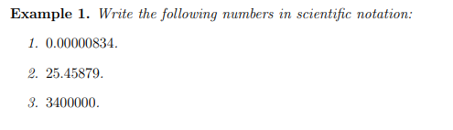
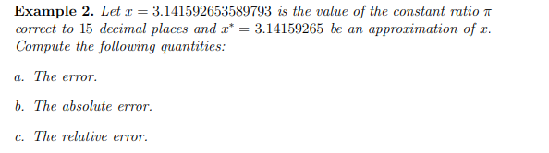
Exercise

Slide 16
